Slide 1
The Battle of Neighborhoods
Capstone Project

Slide 2
Analysis of neighborhood is important
For this project the stakeholders have decided to open a new café in one of the popular Chicago neighborhood’s.
Predicting the most lively neighborhood is important before opening a new café in the particular neighborhood.
Also, predicting the number of café’s in all neighborhood's would also help compare the neighborhood’s and determine the ideal neighborhood for opening a café.

Slide 3
Data acquisition and cleaning
From Wikipedia (url: https://en.wikipedia.org/wiki/List_of_neighborhoods_in_Chicago).
Latitudes and longitudes were obtained using OpenStreetMap API and Geopy.
The data frame was cleaned by dropping null values.
Total 126 values and 4 features in refined data frame.

Slide 4
Analyzing the liveliest neighborhood
As discussed before the ideal place to open a café would be city center.
The Loop is a popular Chicago neighborhood located right in the middle of the city.
Therefore, it would be wise to check the number of café’s located in this area.
According to the analysis 100 venues were returned by foursquare out of which 4 were café’s.
Since, the number of café’s in this area is moderate it would be plausible to open a café in this area. But for more assurance, it would be better to explore other neighborhoods as well.

Slide 5
Analyze other neighborhoods
Other neighborhoods were analyzed as well for more precision.
A new data frame containing relevant information was returned.
Total 2761 values and 7 features in refined data frame.
Will help business person gain more insight in determining the ideal venue.

Slide 6

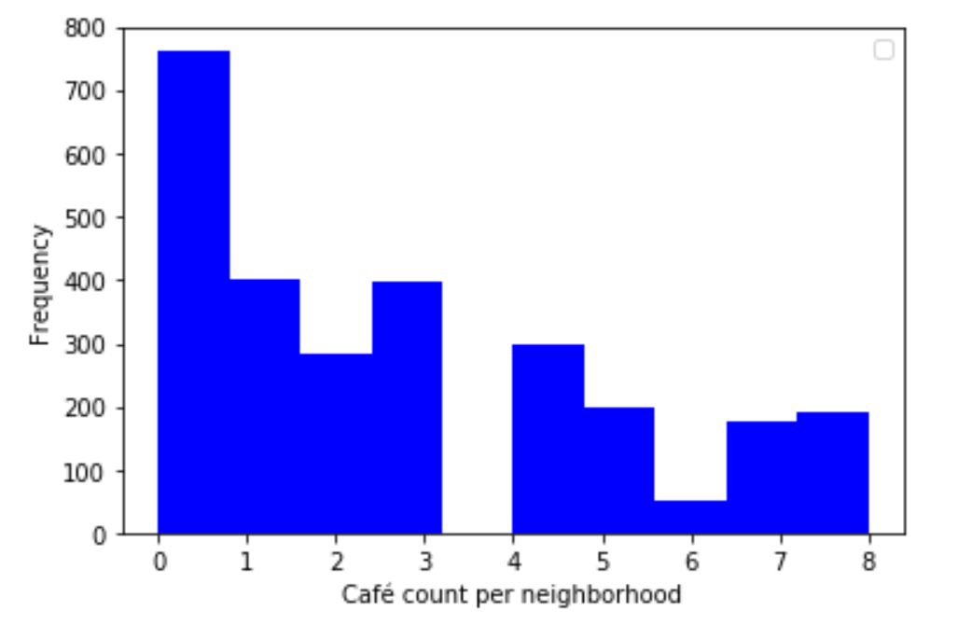
Histogram shows Ideal Neighborhoods to start a new cafe

Slide 7
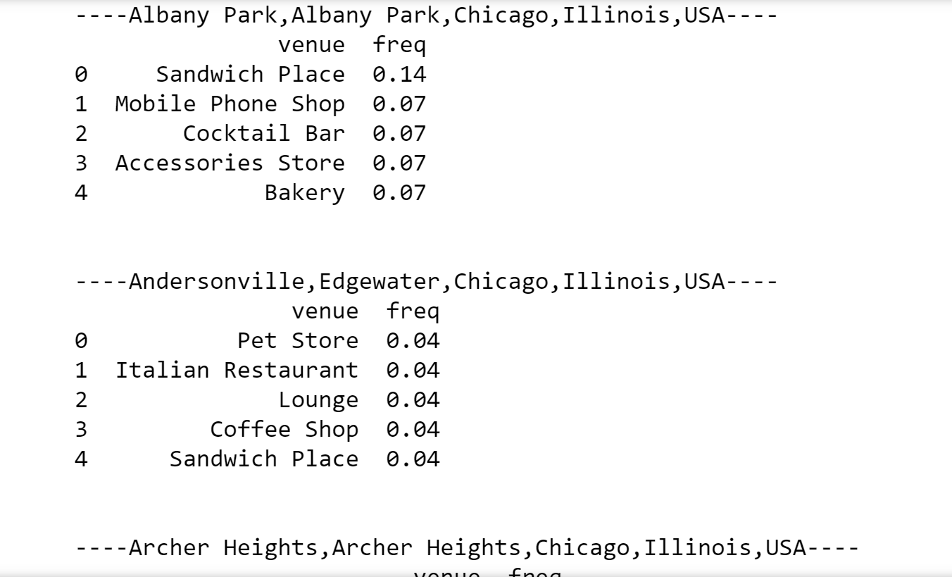
Top 5 venues in each Neighborhood
The figure shows a small snippet of top 5 venues in each neighborhood.
This can be used for further analysis on whether to open a new café in a particular neighborhood.

Slide 8
Future Scope
This project can be modified and used to analyze other venue types as well.
For example; if a business person wants to know whether to open an Asian restaurant or not.
This project can also be expanded to analyze other popular cities and their corresponding venues.

